Slide 1
Python for finance
Lab 1.

Slide 2

Version control system with GitHub
AI generated image using keywords : version control system

Slide 3
What is GitHub ?
Web-based platform that uses Git : a version control system
Manage and collaborate on projects
Tracks changes to your code
Enables teamwork
Organizes your project in repositories

Slide 4

Setting up GitHub
Creating an account
Got to github.com
Sign up for a new account

Slide 5
Key concepts
Repository (Repo): A storage space on GitHub where your project files are kept.
Branch : A separate version of your repository. The main branch is usually called ‘main’.
Commit : A record of changes made to your files
Pull request : A way to propose changes to a project and get feedback before those changes are merged into the main branch

Slide 6
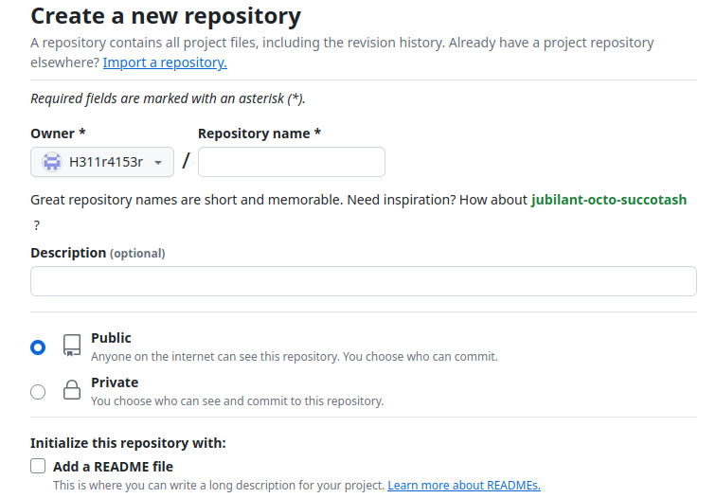
Creating a new repository
Click the ‘+’ icon (top-right) and select ‘New repository’
Give a name for the repo
Add a description, decide on the visibility, check the box ‘initialize with a README’

Slide 7
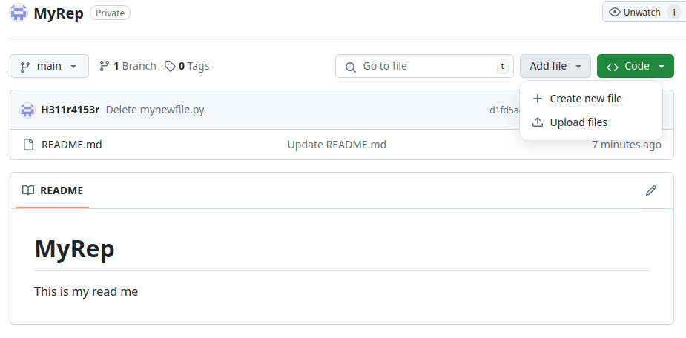
Creating a new file

Slide 8
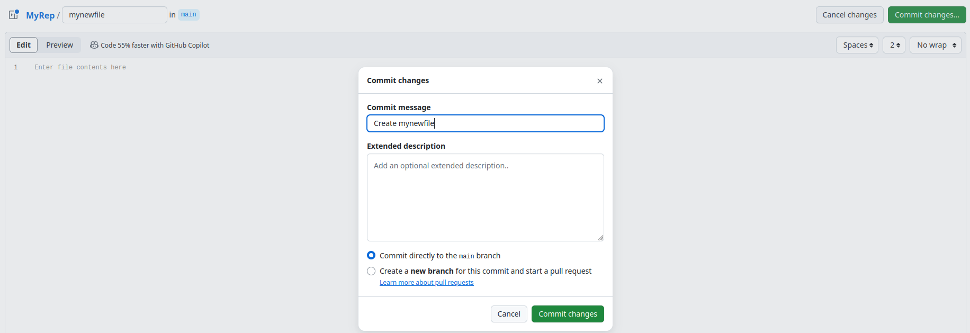
Creating a new file
Add a name, and click on ‘commit changes’
Select ‘commit directly to the main branch’

Slide 9
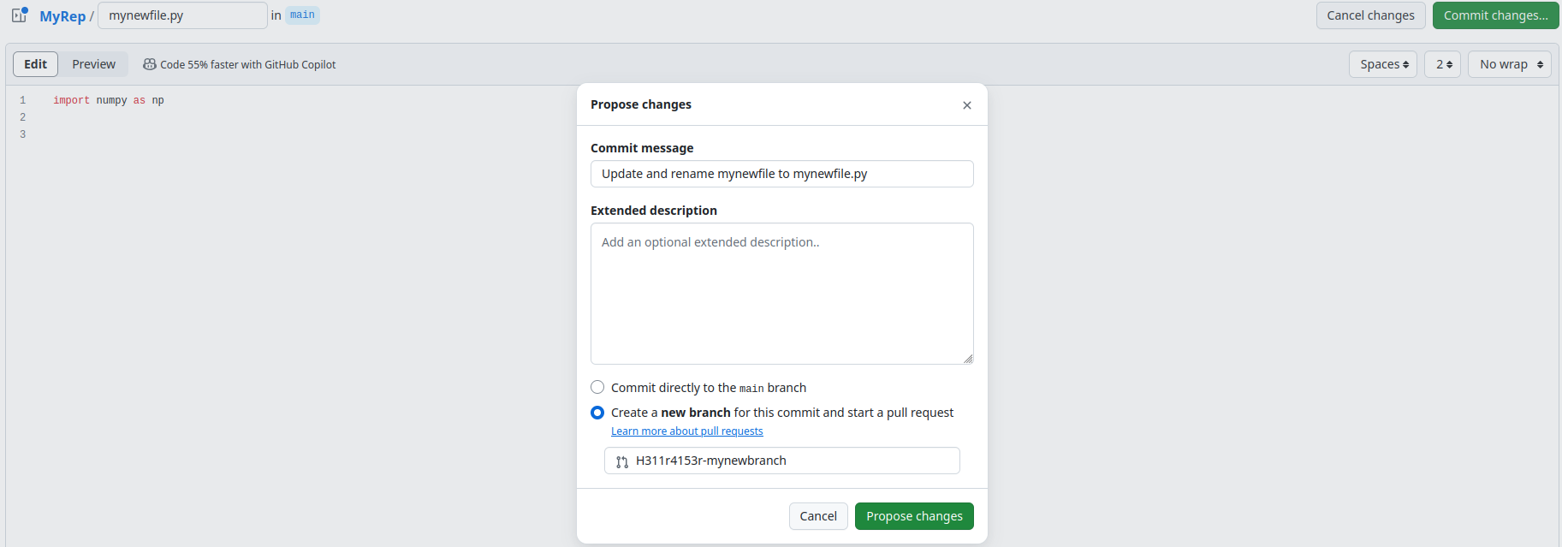
Updating files, creating branches and pull requests
Click on your new file and edit it by clicking the pencil icon on the top right
Add some content, click ‘commit changes’ and select ‘Create a new branch’

Slide 10
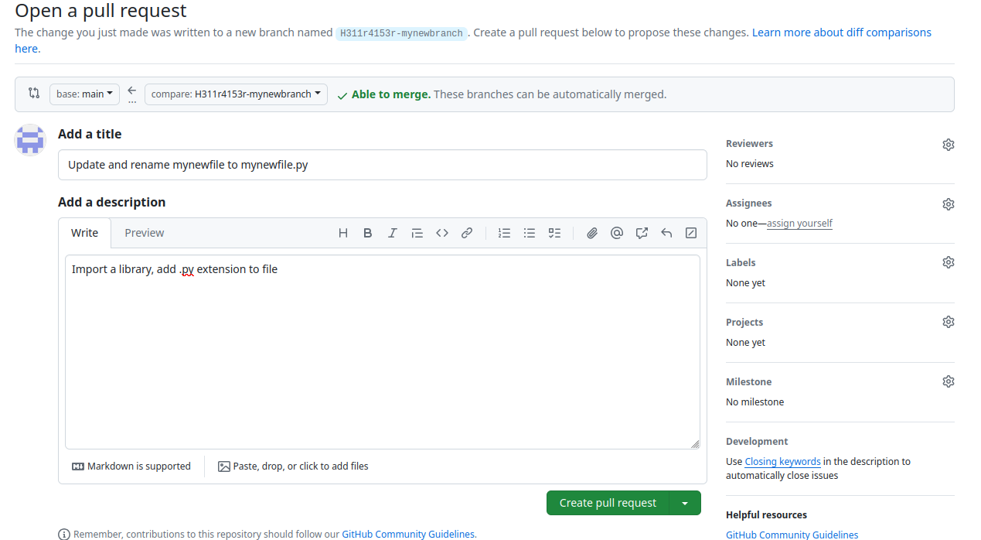
Updating files, creating branches and pull requests
Add a description and create the pull request

Slide 11
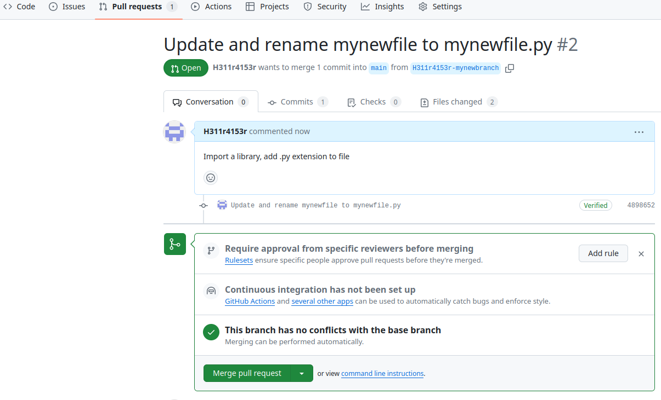
Updating files, creating branches and pull requests
Confirm the merge with the main branch
This process facilitates collaborative work in parallel on branches

Slide 12

Google Colab
AI generated image using keywords : Google colab

Slide 13
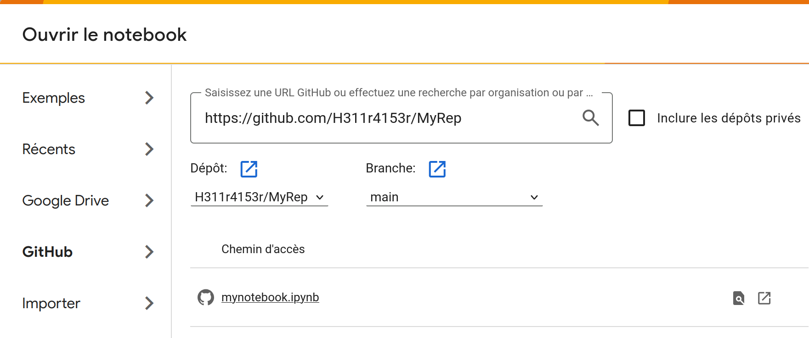
Creating a Google Colab notebook
Log into Google Colab
Go to File -> Open Notebook

Slide 14
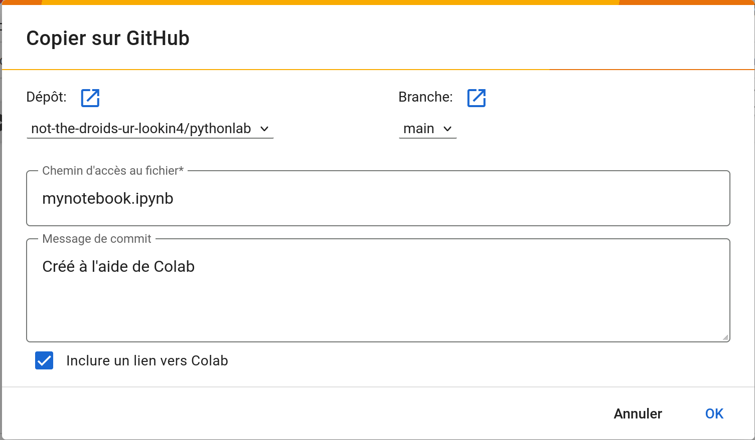
Linking Google Colab and GitHub
Open the new notebook
Go to File -> Save a copy in GitHub (Colab will ask for authorization)

Slide 15
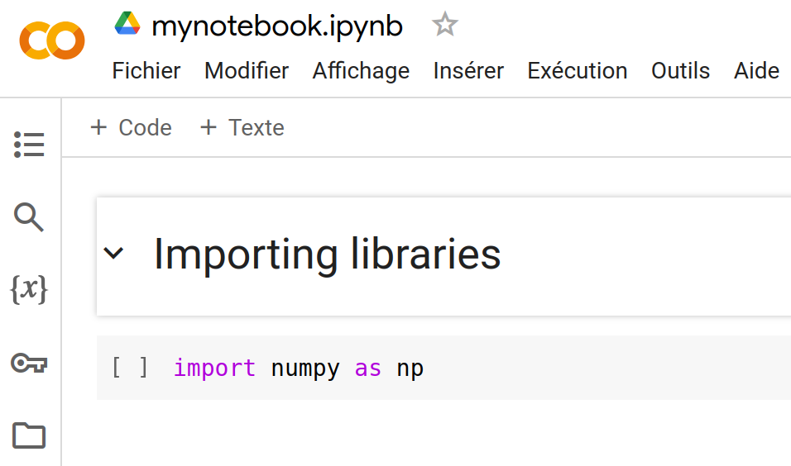
Writing text and code in Google Colab
Click on the ‘Text’ icon, it will open a cell in which you can write and format text
Click on the ‘Code’ icon, it will open a cell in which you can write code

Slide 16
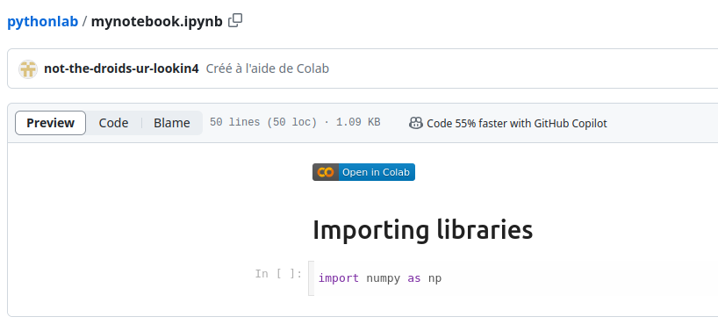
Save to GitHub
Go to File -> Save a copy on GitHub
You can directly use the colab link to jump from GitHub to Colab

Slide 17

Programming exercises
AI generated image using keywords : python programming exercises

Slide 18
Part 1. Conditional statements
Exercise 1. Write a function that determines if a year (given as parameter) is a leap year or not. The function should return a Boolean value. A year is a leap year if it is divisible by 4, unless it is also divisible by 100, with the exception that a year divisible by 400 is a leap year.
Exercise 2. Write a function that takes two lists of integers as parameters, representing intervals. The function must check that each list contains exactly 2 elements, and computes the union and the intersection of the two intervals.

Slide 19
Part 2. Loops
Exercise 3. Write a function that determines if a number given as parameter is a perfect number. A perfect number is a positive integer equal to the sum of its positive proper divisors (divisors excluding the number itself).
Exercise 4. Write a function that returns the min and max values of a list given as parameter.

Slide 20
Part 2. Loops
Exercise 5. Write a function that checks if a list given as parameter is a Fibonacci sequence.
Exercise 6. Write a function that takes as input a two-dimensional list and computes the average for each row in the list. The function should return a list containing the average value of each row.

